Slide 1
МАСТЕР-КЛАСС по английскому языку Подготовка учащихся к ЕГЭ: обучение написанию личного письма
Подготовила: Р.М.Мухтарова,
учитель английского языка

Slide 2
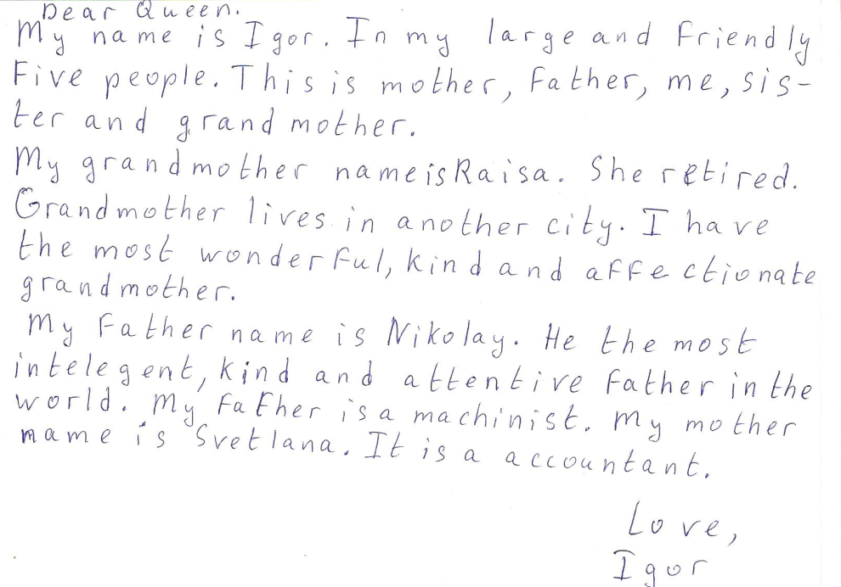
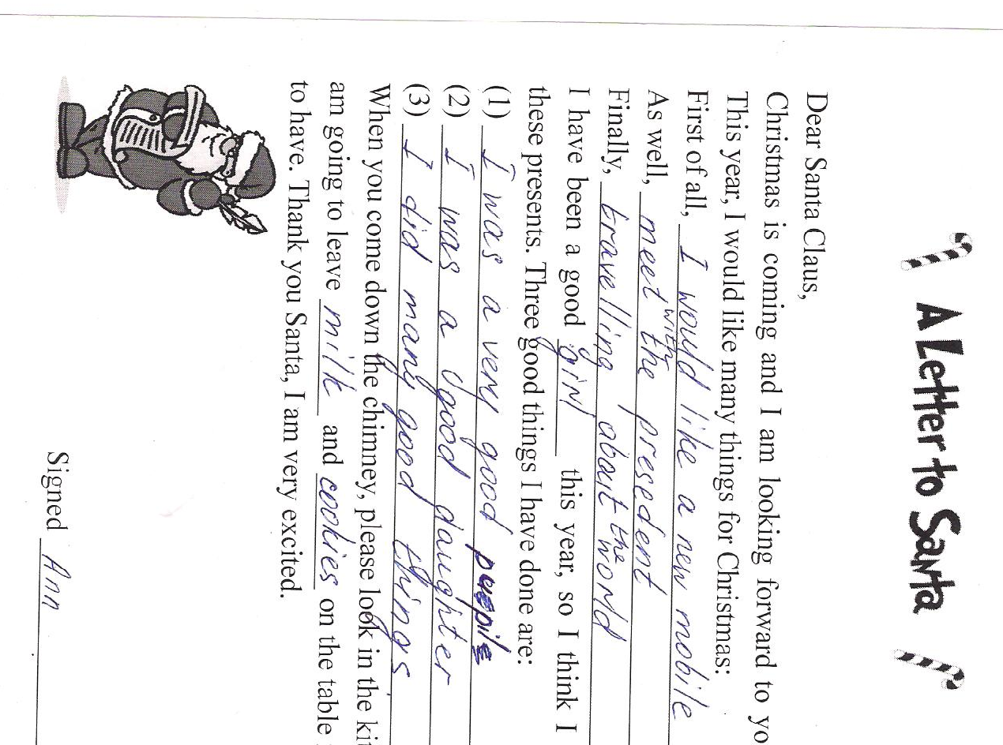
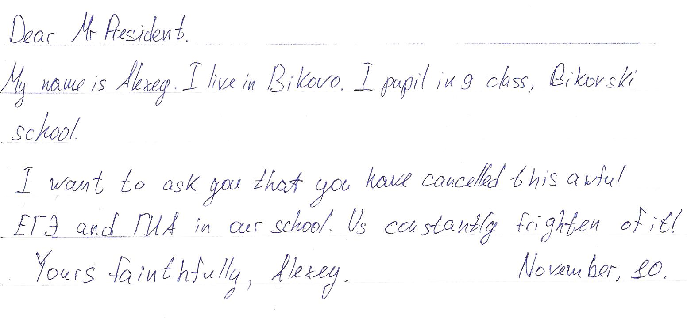

Slide 3
43 Hill Road
Newcastle
NE 3889 U
UK
March 31, 2011
Dear Ann,
I have great news! I’m going to spend last month of my holidays on my grandparents’ farm. I am really excited. We will swim in the river and go fishing.
Write soon. Let me know how your French is going. See you in August!
Best wishes,
Julia
Heading
Greeting
Body
Closing
Signature

Slide 4
I must finish my letter because I've got loads of work. By the way, my sister Vika is coming soon.
B. I'm sorry to hear you've had an argument with your neighbor and that you're not speaking at the moment. Yes, it has happened to me too, and it's awful, isn't it?
C. Yours,
Lena
D. Dear Ruslana,
E. Write back soon!
F. Thanks for your letter. It was so interesting to read about your children, especially about the youngest one.
G. I think you need to ask yourself one question: what's more important - that argument or your relationship? I remember when I asked myself that it all became clear. I realized my friendship with Chris was far more important. I called him immediately and told him. We became friends again immediately. Maybe you should do the same thing. Let me know what happens! Good luck!
H. 23 Portland Street
Manchester
MN3 6YL
10th May, 2011

Slide 5
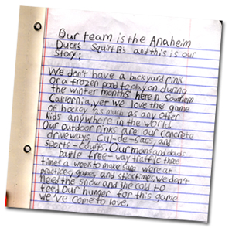
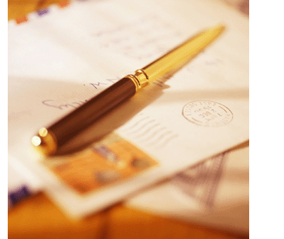
ЕГЭ: выполнение задания С1

Slide 6
Письмо личного характера
объем – 100-140 слов
время – 20 мин.
максимальный балл – 6

Slide 7
Умения
дать развернутое сообщение;
запросить информацию;
использовать неофициальный стиль;
соблюдать формат

Slide 8
You have 20 minutes to do this task.
This is part of a letter from your English pen friend.
…Do you often have arguments with your parents? I do. My mother thinks that I spend too much time watching TV. Do you often watch TV?
What programmes do you like best and why? And what do you do when you disagree with your parents about the programmes to watch?
Write back soon.
Love,
Ann
Write back to Ann answering her questions.
Write 100-140 words.
Remember the rules of letter writing.
8

Slide 9
flat number
house street
city (town, village)
country
index
ЛУЧШЕ
city (town, village)
country
 |  |  | Your address
 |  | Date, Month
Greeting
(PAST)
(ANSWER PART 1)
(ANSWER PART 2)
FUTURE
Closing Line
Name
date/month/year (BE)
month/date/year (AE)
Dear Sally,
Dear Sally,
ссылка на
предыдущий контакт;
извинение, что
не ответил раньше
основная часть
ответы на вопросы
запрос информации
постановка вопросов
в соответствии с
заданием
подпись автора
(имя на отдел. строке)
упоминание
о дальнейших
контактах
завершающая фраза
9

Slide 10
Flat 21
15 Gorky Street
Moscow
Russia
Moscow, Russia
12th January
(June, 8
08.06.2009)
Dear Sally,
Thank you for your recent letter. (It was great to hear from you again
after such a long time.)
I’m sorry for not replying to you sooner but I’ve been extremely busy.
Your answers
Your questions
That’s all my news for now. Write back soon.
Yours, (Love, Best wishes, …)
Anna
P.S.(…)

Slide 11
Критерии оценивания С1
содержание (3 балла)
организация текста (3 балла)
«Содержание» 0 баллов – все задание 0.
Отклонение в объеме +/- 10%: от 90 до 154 слов
менее 90 слов – не подлежит проверке!
более 154 слов – проверка только 140 слов!

Slide 12
Типичные ошибки
Нет адреса или даты , неправильное их расположение
Обращение. Единственный вариант Dear (ИМЯ)
Нет благодарности за письмо или оно неверно сформулировано.
Нарушены правила пунктуации
Нет логической связи
Нет предпрощальной фразы
Неправильная прощальная фраза и подпись
При делении на абзацы нужно либо делать красную строку, либо делать заметный пропуск между абзацами
Не соблюден объем письма

Slide 13
St Petersburg, Russia
June 8-th, Monday
Dear Tom,
I’m very glad to get a letter from you! How are you getting on? How is your brother John?
You are asking me about my new classmate Mary . I’ll do my best to answer your questions. She is a very nice girl. She likes horse-riding and basketball. I hope we’ll become great friends.
By the way, what exams have you got this year? Do you have extra classes? What are you going to do on summer holidays? I must finish my letter because I have to do my homework.
I’m looking forward to hearing from you soon.
Best wishes,
Misha

Slide 14
23 Portland Street
Manchester
MN3 6YL
10th May, 2011
Dear Ruslana,
Thanks for your letter. It was so interesting to read about your children, especially about the youngest one.
Bykovo,
Russia
May 11th, 2011
Dear Lena,
Thanks for your letter. It was great to hear from you.

Slide 15
I'm sorry to hear you've had an argument with your neighbor and that you're not speaking at the moment. Yes, it has happened to me too, and it's awful, isn't it?
I think you need to ask yourself one question: what's more important - that argument or your relationship? I remember when I asked myself that it all became clear. I realized my friendship with Chris was far more important. I called him immediately and told him. We became friends again immediately. Maybe you should do the same thing. Let me know what happens! Good luck!
You are asking me about the argument with my neighbor. I have thought about the problem a lot. You were right our relationship is much more important than that argument about my neighbor’s dog. Liza is a very nice girl. She always helps me when I’m in need. Sometimes she looks after my children. I try to help her as well. So I am going to call Liza and invite her for a cup of tea.

Slide 16
I must finish my letter because I've got loads of work. By the way, my sister Vika is coming soon.
Write back soon!
Yours,
Lena
By the way, I would like to ask you some questions about your sister’s visit. When is she coming? Is she on her holidays? Will she come alone or with her husband?
Hope to hear from you soon.
Love,
Ruslana

Slide 17
www.ege.edu.ru
www.fipi.ru

Slide 18
Благодарю за участие!

